Slide 1
(Hybrid System)
Evolutionary Neural Networks
By Greg

Slide 2
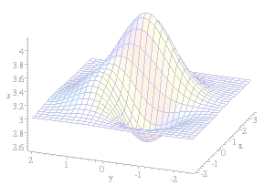
Introduction
Neural networks are used for solving a variety of problems,
But they still have some limitations:
  Neural network training cannot guarantee an optimal solution.
    Eg. the back-propagation algorithm might converge to a set of sub-optimal weights.
  Designing a neural network topology is still more art than engineering.
Genetic algorithms are an effective optimisation technique that can guide both weight optimisation and topology selection.
JST - Evolutionary Neural Networks

Slide 3
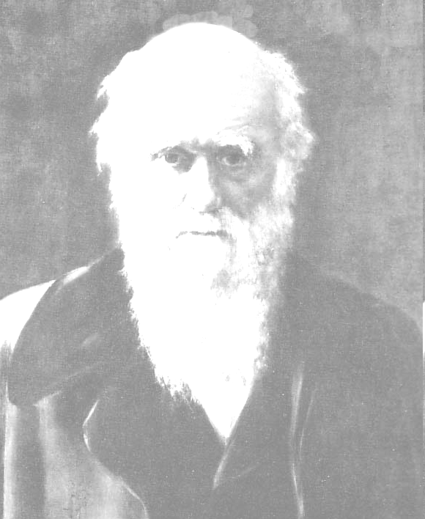
What is a Genetic Algorithm?
Genetic algorithms => Adaptive heuristic search based on the evolutionary ideas of natural selection and genetics (Darwin’s Theory).
Solution
  The array (of a possible solution) represents a chromosome
  An element of array would represent a gene
Chromosomes are broken up and recombined using genetic operators (crossover and mutation) to create (an often better) new solution.
A set of possible solution (a population) are generated and evaluated.
JST - Evolutionary Neural Networks

Slide 4
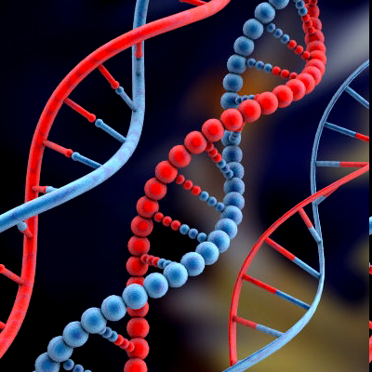
Biological Background
Chromosomes: strings of DNA and serves as a model for the organism.
The chromosomes consist of genes (blocks of DNA) that each has encoded a trait, which determines attributes of the organism (eye color, hair color, height, etc).
  The possible settings for a trait are called alleles.
  The position of a gene in the chromosome called locus.
The complete set of the all chromosomes is called genome.
The set of genes in a genome is called genotype.
JST - Evolutionary Neural Networks

Slide 5

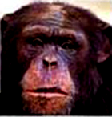
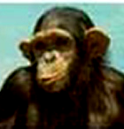


Biological Background
Reproduction:
Crossover ⇨ When the parents “meet” to form a whole new chromosome.
The new offspring can be mutated.
  Mutation causes the elements of the DNA to be changed slightly.
  This change is mainly caused by errors in copying genes from parents.
The Fitness of an organism is determined by the success of an organism in its life.
JST - Evolutionary Neural Networks

Slide 6
GA Basic Description
They are built to solve one specific problem.
They are built to mimic the processes of organic microevolution.
  Much easier adapt to changes.
  Much more efficient at optimization.
They are better at handling more complex, poorly understood searches.
  Generating some possible solutions,
  determining the 'fitness' of each,
  'breeding' new solutions by combining the most fit 'parents‘ solutions.
  This goes on until an optimized solution is reached.
JST - Evolutionary Neural Networks

Slide 7
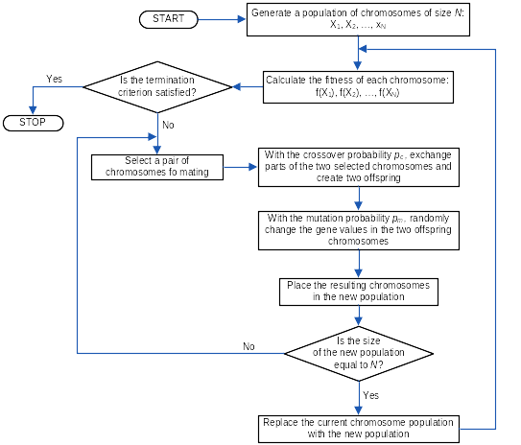
The Basic Genetic Algorithm (Flowchart)

Slide 8
The Basic Genetic Algorithm
Generate a population of chromosomes of size N: X₁, X₂, …, X_{N}
Calculate the fitness of each chromosome: f(X₁), f(X₂), …, f(X_{N})
Is the termination criterion satisfied? If True then STOP else do Step 4 to 8
  Select a pair of chromosomes of mating
  With the crossover probability p_{c}, exchange parts of the two selected chromosomes and create two offspring
  With the mutation probability p_{m}, randomly change the gene values in the two offspring chromosomes
  Place the resulting chromosomes in the new population
  Is the size of the new population equal to N? If False then go to Step 4 else continue to the next step.
Replace the current chromosome population with the new population then go to Step 2.
JST - Evolutionary Neural Networks

Slide 9
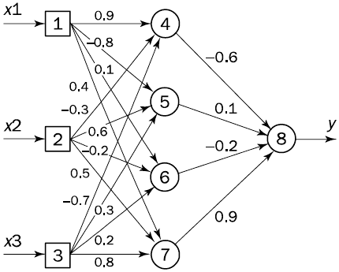
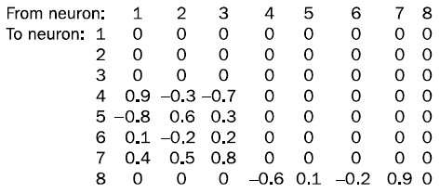
Hybrid GA & Feed Forward NN
(Encoding a set of weights in chromosomes)
Multilayer feedforward neural network
Array of Weight
Chromosomme:
JST - Evolutionary Neural Networks

Slide 10
Hybrid GA & Feed Forward NN
(Encoding a set of weights in chromosomes)
The set of weights can be represented by a square matrix.
  a real number corresponds to the weighted link from one neuron to another.
  0 means that there is no connection between two given neurons.
  Each row represents a group of all the incoming weighted links to a single neuron.
Initial weights are chosen randomly within some small interval, say (-1, 1).
If we string the rows of the matrix together, ignoring zeros, we obtain a chromosome.
  Each row should be allowed to stay together passing genetic material from one generation to the next.
  we should associate each gene with a group of all incoming weights of a given neuron, not with a single weight.
JST - Evolutionary Neural Networks

Slide 11
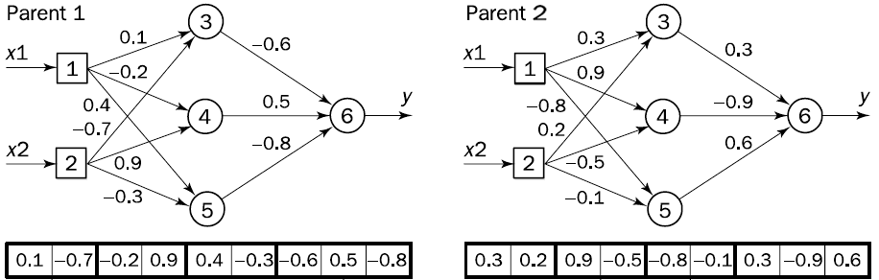
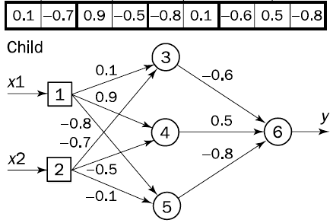
The Genetic Operator - Crossover
Randomly select two parent chromosomes and creates a single child with genetic material from both parents.
Each gene in the child’s chromosome is represented by the corresponding gene of the randomly selected parent.

Slide 12
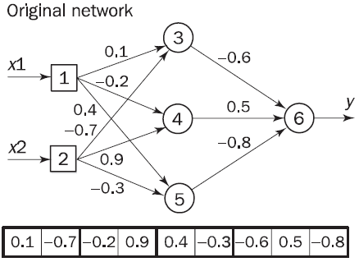
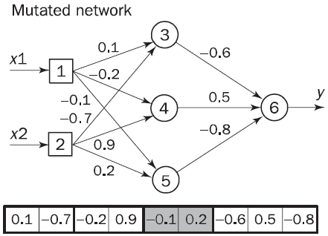

The Genetic Operator - Mutation
Adds a small random value between -1 and 1 to each weight
Select random gene
JST - Evolutionary Neural Networks

Slide 13
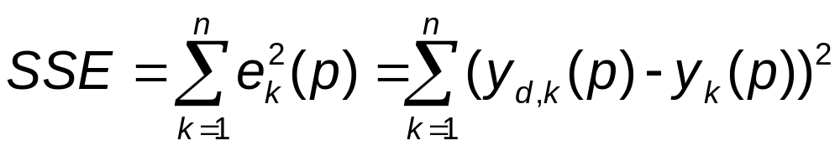
Define The Fitness Function
The Fitness function must estimate the performance of a given neural network.
  Use The Sum of Squared Errors.
Evaluate the fitnes of a given chromosome:,
  Assign each weight in the chromosome to the respective link of the network.
  Present n training set of examples to the network.
  Calculate the Sum of Squared Errors.
  The smaller the sum, the fitter the chromosome.
In other words, the genetic algorithm attempts to find a set of weights that minimises the sum of squared errors.
JST - Evolutionary Neural Networks

Slide 14
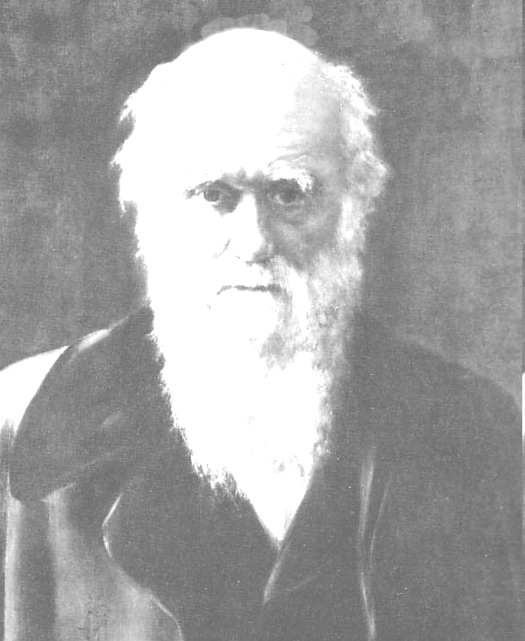
Selection Operators
According to Darwin’s theory of evolution:
“The best ones should survive and create offspring”
JST - Evolutionary Neural Networks

Slide 15
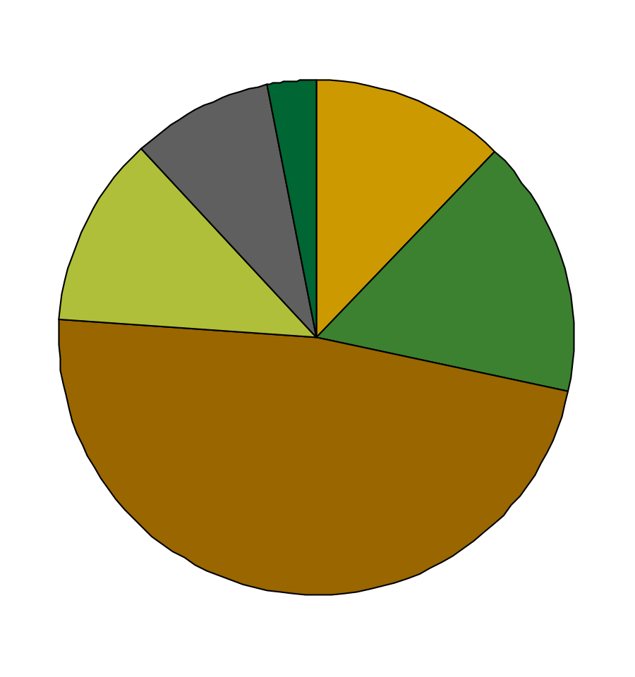
Selection Operators
Roulette Wheel Selection:
The chromosomes are selected according to their fitness.
The better the chromosomes are, the more chances to be selected.
The Population is a roulette wheel where all chromosomes are placed according to its fitness.
JST - Evolutionary Neural Networks

Slide 16
Selection Operators
Roulette Wheel Selection Algorithm:
Calculate the sum of all chromosome fitnesses in the population → sum S.
Generate random number from interval (0, S) → r.
Go through the population and sum fitnesses from 0 - sum S. When the sum S is greater then r, stop and return the chromosome where you are.
JST - Evolutionary Neural Networks

Slide 17
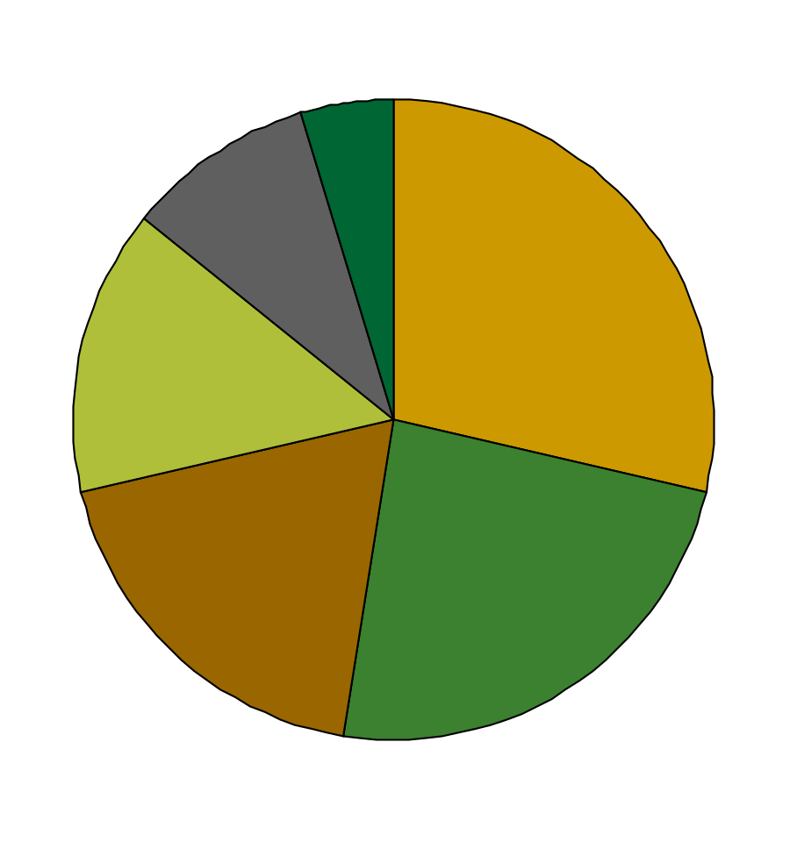

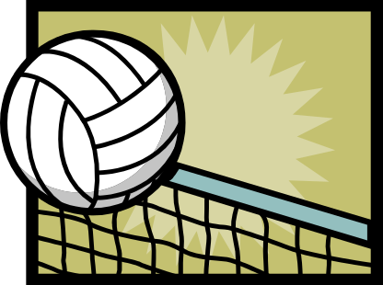
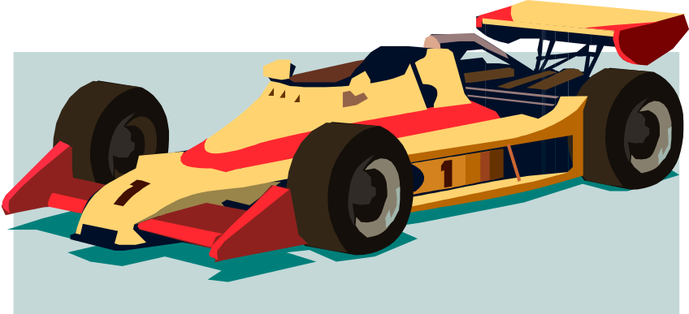
Selection Operators
Rank Selection:
First ranks the population, then every chromosome receives its fitness from this ranking.
  The worst will have a fitness 1 and the second worst will have a fitness 2 and so on.
  The best will have a fitness N where it is the number of chromosomes in the population.
JST - Evolutionary Neural Networks

Slide 18


Selection Operators
Steady State Selection:
The main idea:
  A good part of the chromosomes should survive to the next generation.
  In every generation select a few with high fitness for creating offspring,
  Some with low fitness are removed and the new offspring put in its place.
The rest of the population survives to the next generation.
Not really a good method of selection.
JST - Evolutionary Neural Networks

Slide 19


Selection Operators
Elitism / Truncation:
“When creating a new population by crossover and mutation there is a chance that we will loose the best chromosome.”
The best or the best few chromosomes are copied to a new population
The rest done in the classic way:
  Roulette Wheel
  Rank Selection
This method can rapidly increase the optimality of the genetic algorithm by not loosing the best found solutions.
JST - Evolutionary Neural Networks

Slide 20
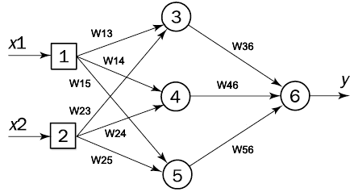
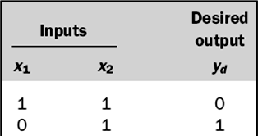
Latihan:
Training Set
Fungsi Aktivasi: Binary Sigmoid
1
f(s) = Y^{sigmoid} =
1 + e^{-S}
Kromosom Awal (Random):
Cr 1: | 0.1 | -0.7 | -0.2 | 0.6 | 0.4 | -0.3 | -0.3 | 0.5 | -0.8
Cr 2: | 0.3 | 0.2 | 0.9 | -0.5 | -0.8 | -0.1 | 0.3 | 0.9 | -0.6
Cr 3: | 0.5 | 0.1 | -0.8 | 0.3 | 0.2 | -0.5 | 0.6 | 0.2 | -0.4
Populasi Maksimal: 5 Kromosom
Operator Seleksi: Elitism
  Kromosom terbaik dikopikan ke populasi yang baru
Operator Crossover: Dua kromosom lain di-crossover seperti contoh dan sebaliknya.
Operator Mutasi: Mutasi dilakukan pada child kromosom terjelek, pada gen random (misal utk. Iterasi 1, nilai random utk mutasi = (-0.3, 0.1))
Soal (nilai 10): Lakukan proses sampai iterasi 1 saja max iterasi (ditentukan), dan cari kromosom terbaik.
Program dikumpulkan (ditunjukkan) minggu depan (nilai 30)

Slide 21
Latihan:
Training Set
Fungsi Aktivasi: Bipolar Sigmoid
2
f(s) = Y^{sigmoid} =
- 1
Kromosom Awal (Random):
1 + e^{-S}
Cr 1: | 0.4 | -0.7 | -0.2 | 0.5 | 0.4 | -0.6 | -0.6 | 0.7 | -0.8
Cr 2: | 0.3 | 0.2 | 0.5 | -0.5 | -0.6 | -0.1 | 0.3 | -0.9 | 0.6
Cr 3: | 0.2 | -0.1 | 0.8 | 0.3 | -0.7 | 0.2 | 0.6 | 0.2 | -0.4
Populasi Maksimal: 3 Kromosom
Operator Seleksi: (Modified) Steady State
  Semua kromosom pada populasi sekarang (current) dicopy-kan ke populasi baru.
Operator Crossover: Dua kromosom terbaik di-crossover seperti contoh dan sebaliknya.
Operator Mutasi: Mutasi dilakukan pada child kromosom terjelek, pada gen 2 (misal utk. Iterasi 1, nilai random utk mutasi = (-0.3, 0.1))
Seleksi: Setelah mutasi (ada 3 parent + 2 child), dua kromosom terjelek di-eliminasi.
Soal (nilai 12): Lakukan proses sampai iterasi 1 saja. (nilai +10) bila mengerjakan iterasi 2, dengan nilai mutasi random (-0.2, 0.2) dan dilakukan pada gen 1 kromosom child terjelek.

